Slide 1
ZONE
Connor Penn, Avery Cuevas, Kayvon Washington and Jake Diaz

Slide 2
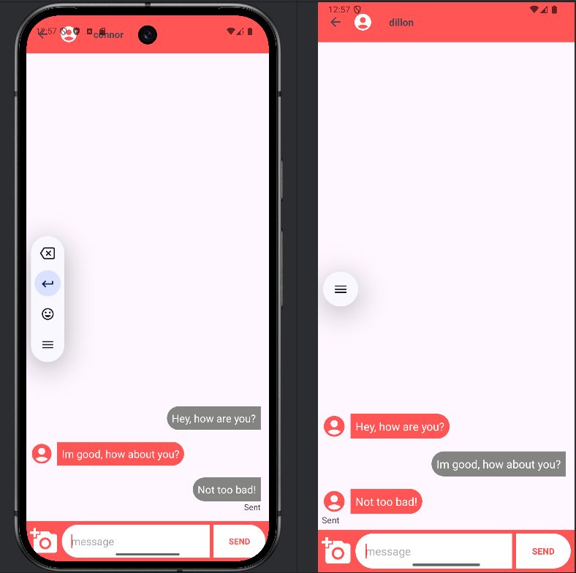
Chat Room
Zone
Chat Activity
Chat Room Activity
The chat room lets you talk to other users that you started chats with.
Users can send images and share links to maps to each other
In the future we want to connect the chats to event items for group conversations

Slide 3
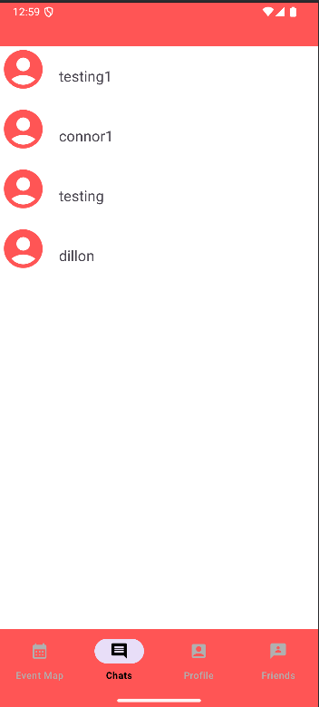
Chat Fragment
Zone
Chat Activity
Existing Chats
The chat fragment allows users to see their existing chats and reopen them be clicking on the usernames
In the future we want to add tags to chats that are connected to events you’re interested in

Slide 4
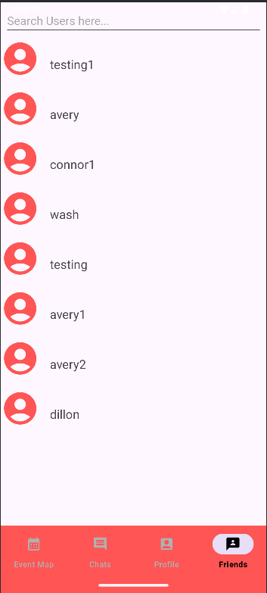
Friend Fragment
Zone
Friend Activity
Start chats and meet new friends
The friend fragment allows people to manually find people and add them
You can currently add people but we will also allow a user to view someone else’s profile

Slide 5
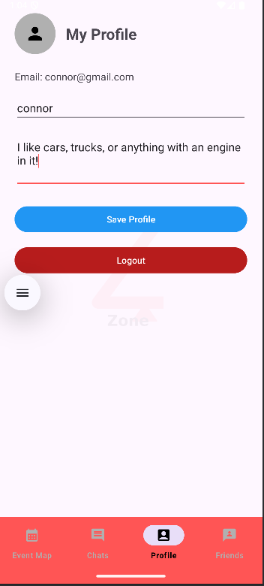
Profile Fragment
Zone
Profile Activity
Change Your Display Name and Description
At the profile fragment you can change your display name or description which will be used to suggest friends in future updates

Slide 6
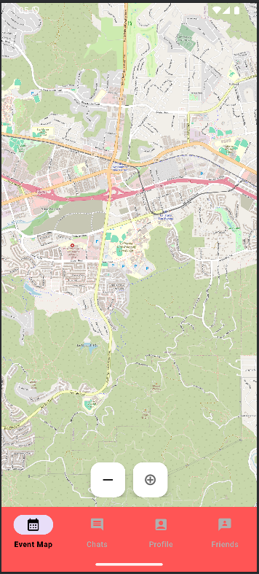
Maps Fragment
Zone
Map Event Activity
Find events and join a chat
The map activity will be used to find events and join chat rooms for that event. For safety purposes, only verified business members will be allowed to start events. But in the future we will add something for private events

Slide 7
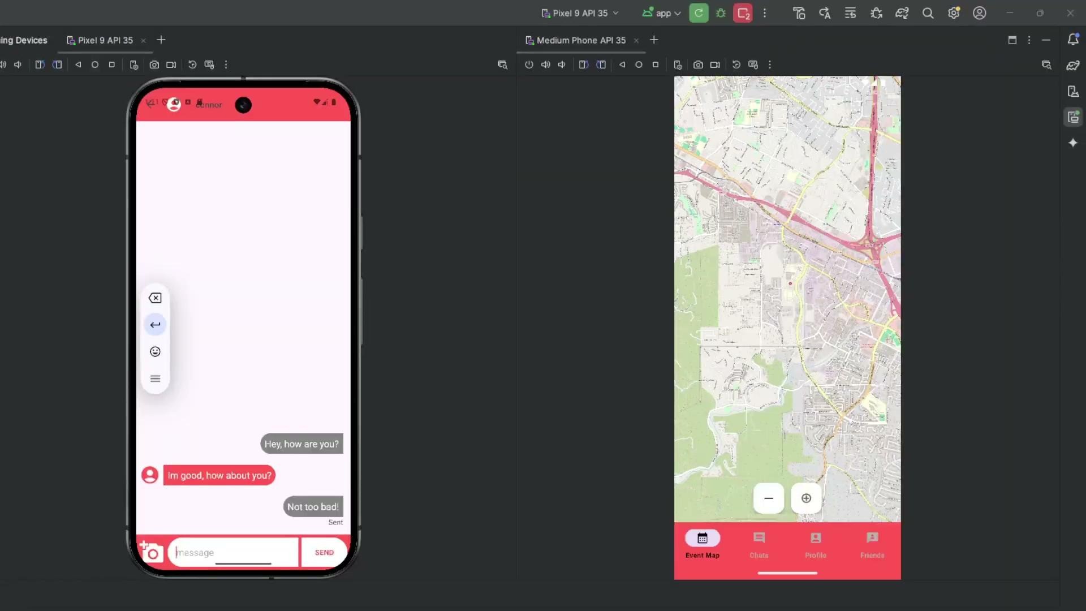
Zone
LIVE DEMO SEGMENT

Slide 8
THANKS FOR LISTENING
Zone

